Slide 1
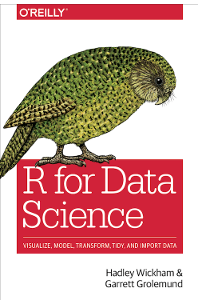
Chapter 5: Data transformation https://r4ds.had.co.nz/transform.html

Slide 2
Weekly Strategy
Powerpoint slides with chapter highlights
Chapter review, e.g., workflowbasics.R
Practice coding examples from book together
Work on assignments time permitting
Complete or review the assignment at the beginning of the next scheduled class
Contact me through meetup with question between our meetings

Slide 3
Getting started
Rstudio download?
Open Rstudio
Click on icon or open workflowbasics.R
Pane layout
Source Editor
Console
Workspace Browser (history, environment)
Plots, Files, Packages, Help

Slide 4
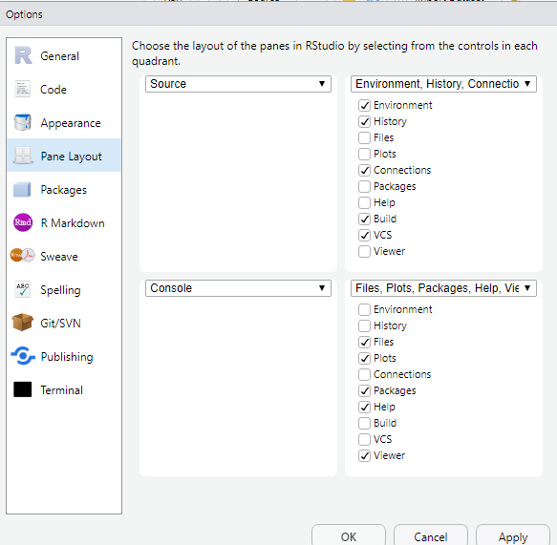
To set up panes:
Tools
→Global Options
→Pane Layout

Slide 5
Rstudio Panes
Source Editor
type code
can save as scripts
as.R text files
Environment/History
view objects
view command history
Console
code is evaluated here
Files, Plots, Packages, Help

Slide 6
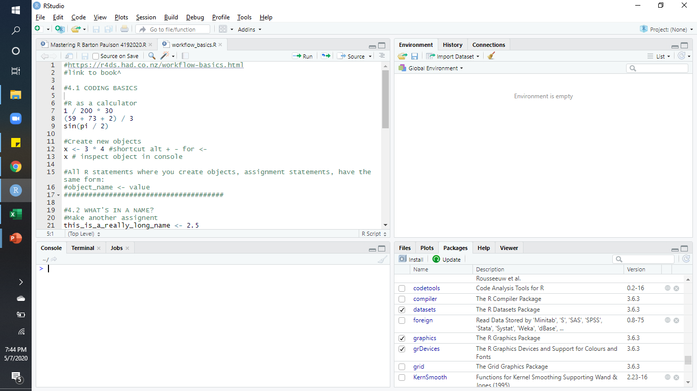

Slide 7
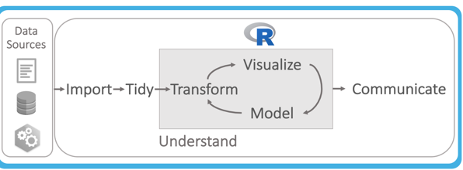
5.1 Introduction
Data can be messy
We need to make it tidy
We can create new variables and summaries

Slide 8
5.1.1 Prerequisites
Load packages
install.packages(nycflights13)
install.packages(tidyverse) – (includes dplyr)
install.packages(ggplot2)
Load libraries
library(nycflights13)
library(tidyverse)
library(ggplot2)

Slide 9
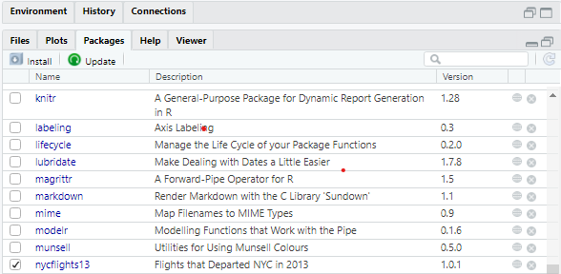
5.1.1 Prerequisites
Once the package is available it will have a check next to it:

Slide 10
5.1.2 nycflights13
Tibbles are tweaked dataframes (tables)
tweaked to make dataframes easier to work with
Explore dataframe
nycflights13::flights
See documentation in help pane
?flights
To see the whole dataset in the console
View(flights)

Slide 11
5.1.3 dplyr basics
dplyr functions:
filter choose observations by value
arrange reorder rows
select choose variables by names
mutate create new variables
summarise collapse values to a single value
group by can be used with all of above

Slide 12

5.2 Filter rows with filter()
1st argument is the dataframe name
filter(flights, month == 1, day ==1)
assignment statement
jan1 <- filter(flights, month == 1, day ==1)

Slide 13
5.2.1 Comparisons
Greater than >
Greater than or equal to >=
Less than <
Less than or equal to <=
Not equal !=
Equal ==
Common problem: floating point numbers
use near()

Slide 14

5.2.2 Logical operators
Use & for and
filter(flights, month == 11 & month == 12)
Use | for or

Slide 15
5.2.3 Missing values
Any operation involving an unknown value will also be unknown
Use is.na() to determine if a value is missing
The filter() function will not acknowledge NA values

Slide 16
5.3 Arrange rows with arrange()
Sort columns by flights then year, month, day
arrange(flights, year, month, day)
results are in ascending order
Use desc to sort columns in descending order
arrange(flights, desc(dep_delay))

Slide 17
5.4 Select columns with select()
You may want to create a subset of your dataset
select variables (columns) of interest to your study
Helper functions to use with select
starts_with()
ends_with()
contains()
matches
num_range()

Slide 18
5.5 Add new variables with mutate()

Slide 19
5.6 Grouped summaries with mutate()

Slide 20
5.7 Grouped mutates (and filters)

